Slide 1
Mining Frequent Patterns, Association and Correlations: Basic Concepts and Methods

Slide 2
Mining Frequent Patterns, Association and Correlations: Basic Concepts and Methods
Basic Concepts
Which Patterns Are Interesting?—Pattern Evaluation Methods
Summary

Slide 3
What Is Frequent Pattern Analysis?
Frequent pattern: a pattern (a set of items, subsequences, substructures, etc.) that occurs frequently in a data set .
Eg a set of items Eg milk and bread --Frequent item set
Sequential Pattern: A subsequence eg PC and then a Digital camera- then a memory card.
Motivation: Finding inherent regularities in data
What products were often purchased together?— Bread and butter?
What are the subsequent purchases after buying a PC?
Can we automatically classify web documents?
Applications
Basket data analysis, cross-marketing, catalog design, sale campaign analysis, Web log (click stream) analysis, and DNA sequence analysis.

Slide 4
Why Is Freq. Pattern Mining Important?
Freq. pattern: An intrinsic and important property of datasets
Frequent pattern mining searches for recurring relationships in a given data set
Foundation for many essential data mining tasks Association, correlation, and causality analysis
Topics
Ex: market basket Analysis
Basic Concepts of mining frequent patterns
Different kinds of patterns, association rules

Slide 5

Market Basket AnalysisAssociation Rules
means that 2% of all the transactions under analysis show that computer and antivirus software are purchased together;
A confidence of 60% means that 60% of the customers who purchased a computer also bought the software.
Rules are considered interesting if they satisfy both a minimum support threshold and a minimum confidence threshold -- set by users or domain experts.
Additional analysis can be performed to discover interesting statistical correlations between associated items.
Occurrence frequency of an itemset: is the number of transactions that contain the itemset. This is also known, simply, as the frequency, support count, or count of the itemset.
Frequent Itemset. If the relative support of an itemset I satisfies a pre-specified minimum support threshold, then I is a frequent itemset.

Slide 6
Market Basket Analysis
Association rule mining can be viewed as a two-step process:
1. Find all frequent itemsets: By definition, each of these itemsets will occur at least as frequently as a predetermined minimum support count, min sup.
2. Generate strong association rules from the frequent itemsets: By definition, these rules must satisfy minimum support and minimum confidence.

Slide 7


A recap of “Combinations”
k-combinations is equal to the binomial coefficient
which can be written using factorials as

Slide 8
Basic Concepts: Frequent Patterns
Tid | Items bought
10 | Bread, Nuts, Butter
20 | Bread, Coffee, Butter
30 | Bread, Diaper, Eggs
40 | Nuts, Eggs, Milk
50 | Nuts, Coffee, Butter, Eggs, Milk
itemset: A set of one or more items
k-itemset X = {x₁, …, x_{k}}
(absolute) support, or, support count of X: Frequency or occurrence of an itemset X
(relative) support, s, is the fraction of transactions that contains X (i.e., the probability that a transaction contains X)
An itemset X is frequent if X’s support is no less than a minsup threshold
Customer
buys both
Customer
buys butter
Customer
buys bread

Slide 9
Basic Concepts: Association Rules
Tid
Items bought
Find all the rules X → Y with minimum support and confidence
support, s, probability that a transaction contains X ∪ Y
confidence, c, conditional probability that a transaction having X also contains Y
Let minsup = 50%, minconf = 50%
Freq. Pat.: Bread:3, Nuts:3, Butter:4, Eggs:3, {Bread, Butter}:3
10
Bread, Nuts, Butter
20
Bread, Coffee, Butter
30
Bread, Butter, Eggs
40
Nuts, Eggs, Milk
50
Nuts, Coffee, Butter, Eggs, Milk
Customer
buys both
Customer
buys butter
Customer
buys bread
Association rules: (many more!)
Bread→ Butter (60%, 100%)
Butter → Bread (60%, 75%)

Slide 10
The Downward Closure Property and Scalable Mining Methods
The downward closure property of frequent patterns
Any subset of a frequent itemset must be frequent
If {bread, jam, nuts} is frequent, so is {bread, jam}
i.e., every transaction having {bread, jam, nuts} also contains {bread, jam}
Scalable mining methods: Three major approaches
Apriori
Freq. pattern growth
Vertical data format approach
NB: An itemset X is frequent if X’s support is no less than a minsup threshold

Slide 11
Apriori: A Candidate Generation & Test Approach
Apriori pruning principle: If there is any itemset which is infrequent, its superset should not be generated/tested!
Method:
Initially, scan DB once to get frequent 1-itemset
Generate length (k+1) candidate itemsets from length k frequent itemsets
Test the candidates against DB
Terminate when no frequent or candidate set can be generated

Slide 12
The Apriori Algorithm—An Example
Sup_{min} = 2
Itemset | sup
{A} | 2
{B} | 3
{C} | 3
{D} | 1
{E} | 3
Database TDB
Itemset | sup
{A} | 2
{B} | 3
{C} | 3
{E} | 3
L₁
Tid | Items
10 | A, C, D
20 | B, C, E
30 | A, B, C, E
40 | B, E
C₁
1st scan
C₂
Itemset | sup
{A, B} | 1
{A, C} | 2
{A, E} | 1
{B, C} | 2
{B, E} | 3
{C, E} | 2
C₂
Itemset
{A, B}
{A, C}
{A, E}
{B, C}
{B, E}
{C, E}
L₂
Itemset | sup
{A, C} | 2
{B, C} | 2
{B, E} | 3
{C, E} | 2
2nd scan
C₃
Itemset
{B, C, E}
3rd scan
L₃
Itemset | sup
{B, C, E} | 2

Slide 13
The Apriori Algorithm (Pseudo-Code)
C_{k}: Candidate itemset of size k
L_{k} : frequent itemset of size k
L₁ = {frequent items};
for (k = 1; L_{k} !=∅; k++) do begin
C_{k+1} = candidates generated from L_{k};
for each transaction t in database do
increment the count of all candidates in C_{k+1} that are contained in t
L_{k+1} = candidates in C_{k+1} with min_support
end
return ∪_{k} L_{k};

Slide 14
Implementation of Apriori
How to generate candidates?
Step 1: self-joining L_{k}
Step 2: pruning
Example of Candidate-generation
L₃={abc, abd, acd, ace, bcd}
Self-joining: L₃*L₃
abcd from abc and abd
acde from acd and ace
Pruning:
acde is removed because ade is not in L₃
C₄ = {abcd}

Slide 15
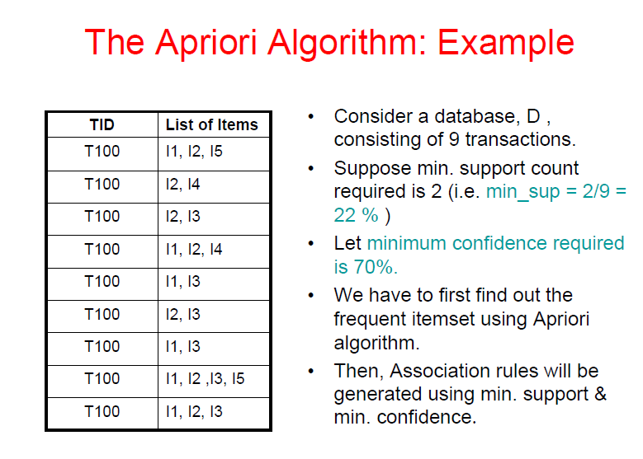

Slide 16
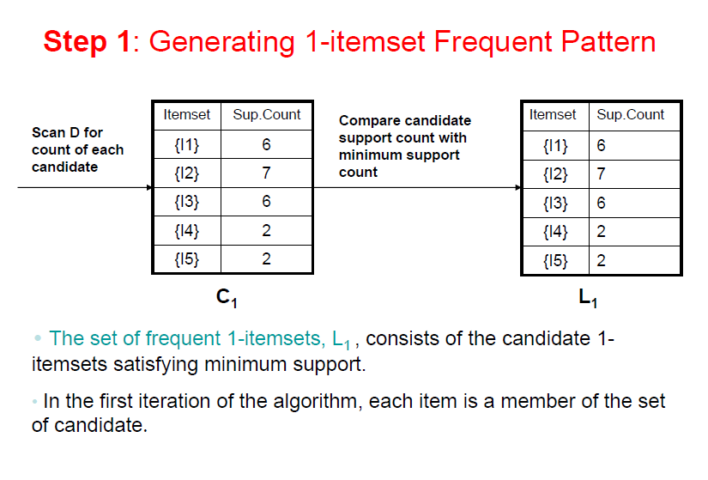
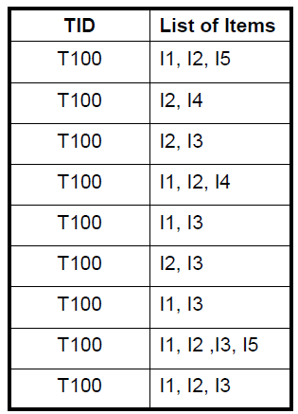

Slide 17
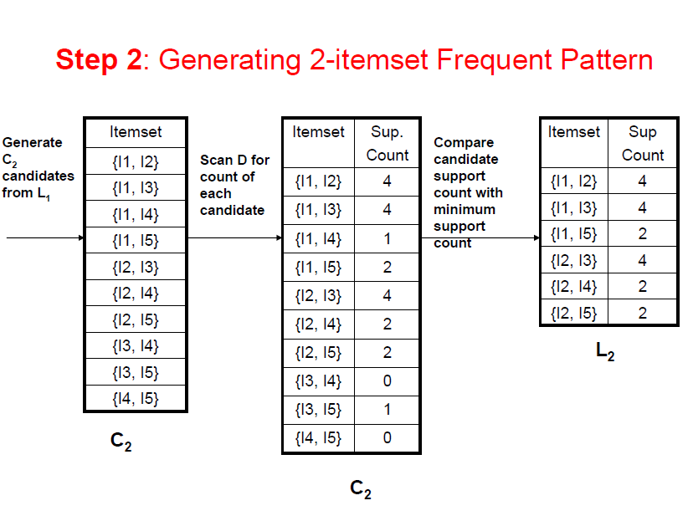

Slide 18
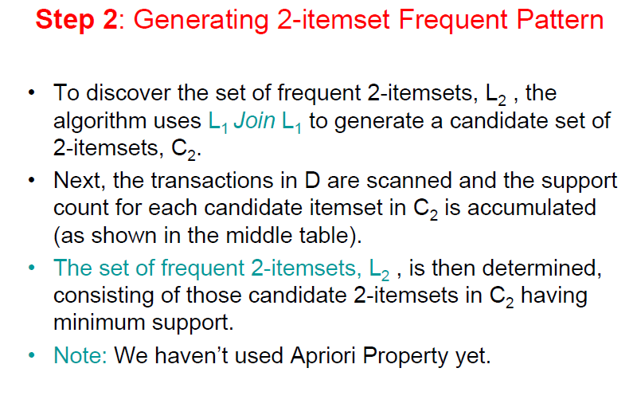

Slide 19
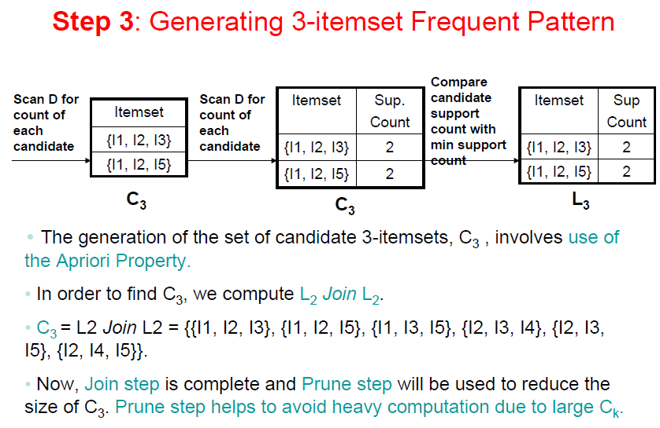

Slide 20
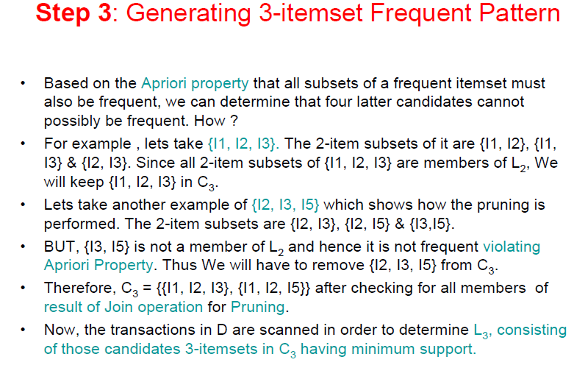
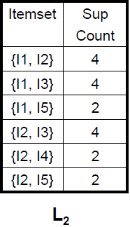

Slide 21
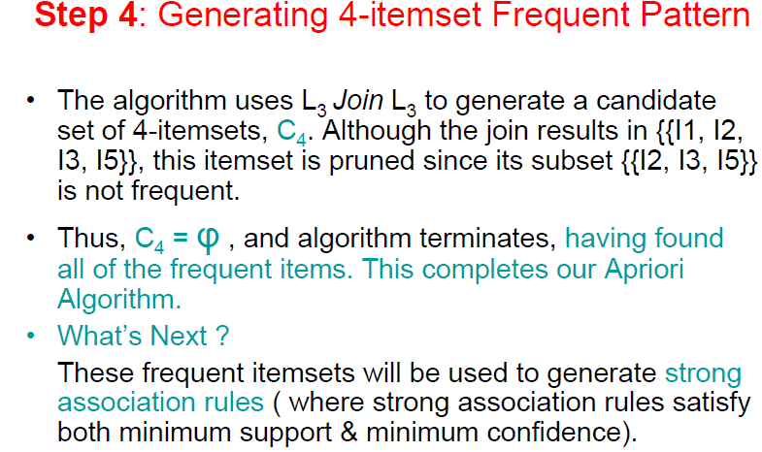

Slide 22
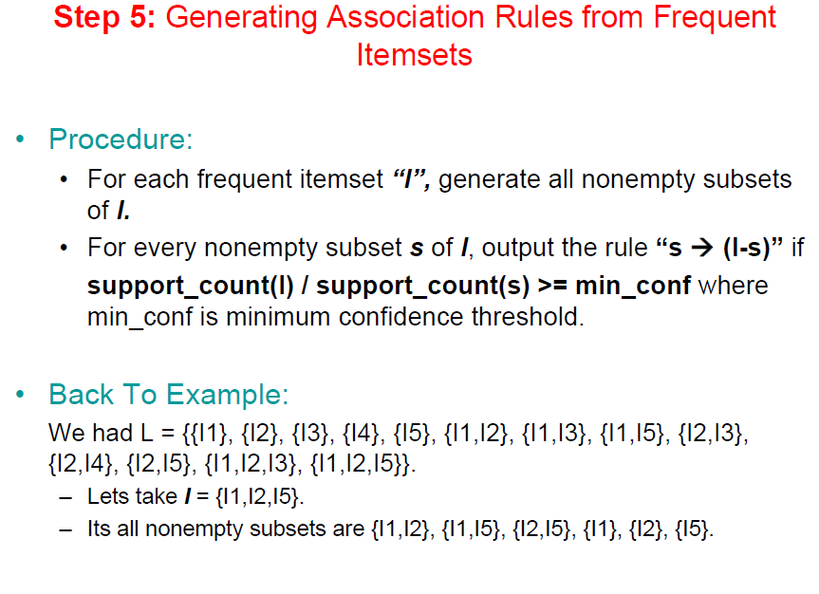

Slide 23

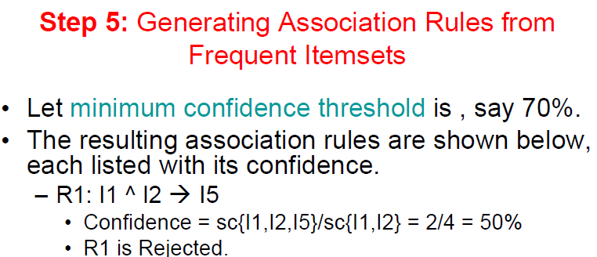

Slide 24
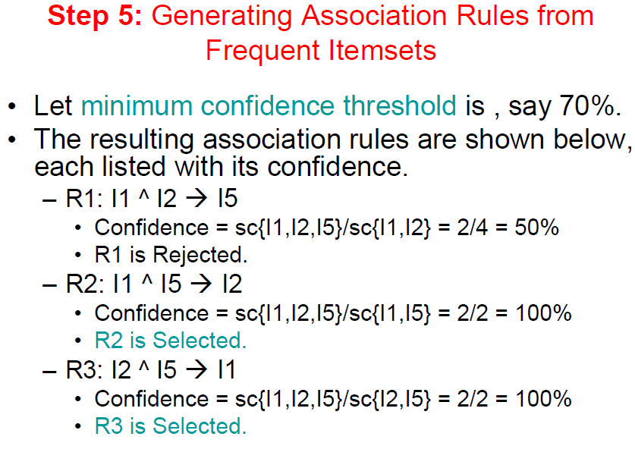

Slide 26
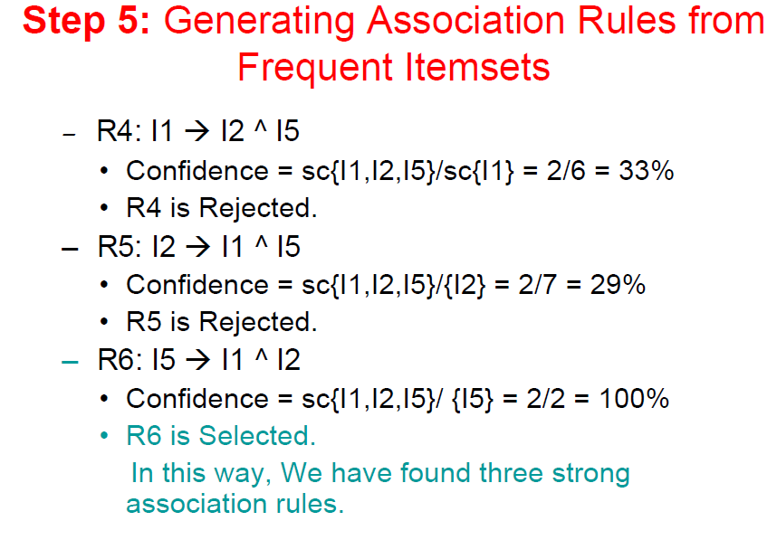

Slide 27
Further Improvement of the Apriori Method
Major computational challenges
Multiple scans of transaction database
Huge number of candidates
Tedious workload of support counting for candidates
Improving Apriori: general ideas
Reduce passes of transaction database scans
Shrink number of candidates
Facilitate support counting of candidates

Slide 28
Reduce the Number of Candidates
A k-itemset whose corresponding hashing bucket count is below the threshold cannot be frequent
Candidates: a, b, c, d, e
Hash entries
{ab, ad, ae}
{bd, be, de}
…
Frequent 1-itemset: a, b, d, e
ab is not a candidate 2-itemset if the sum of count of {ab, ad, ae} is below support threshold
J. Park, M. Chen, and P. Yu. An effective hash-based algorithm for mining association rules. SIGMOD’95
count
itemsets
35
{ab, ad, ae}
88
{bd, be, de}
...
...
102
{yz, qs, wt}
Hash Table

Slide 29
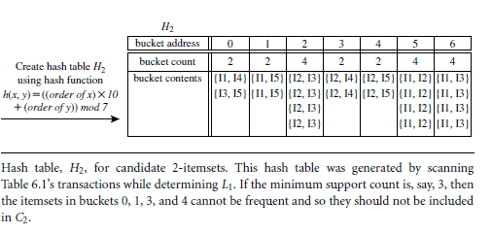
1. Hash-Based Itemset Counting

Slide 30
Ex1
TID | Items
1 | f, a, c, d, g, j, m, p
2 | a, b, c, f, l, m
3 | b, f, h, j, o
4 | b, c, k, s, p
5 | a, f, c, e, l, p, m, n
Requirement-1:
Find all frequent pattern item sets using A-priori algorithm. Consider “Min-Support Count” greater than 2.
Requirement-2:
Generate all association rules if the minimum confidence threshold is greater than 80%

Slide 31
Ex2
TID | Items
1 | Face wash, apple, cologne, dryer, geyser, jam, mangoes, peers
2 | apple, baby cream, cologne, face wash, lace, mangoes
3 | Baby cream, face wash, ham, jam, olive oil
4 | Baby cream, cologne, kit-kat, sniggers, peers
5 | apple, face wash, cologne, ear buds, lace, peers, mangoes, neem
Requirement-1:
Find all frequent pattern item sets using A-priori algorithm
Consider “Min-Support Count” greater than 2.
Requirement-2:
Generate all association rules if the minimum confidence threshold is greater than 90%

Slide 32
Mining Frequent Patterns, Association and Correlations: Basic Concepts and Methods
Basic Concepts
Frequent Itemset Mining Methods
Which Patterns Are Interesting?—Pattern Evaluation Methods
Summary

Slide 33
Association Mining to Correlation Analysis

Slide 34
Introduction
Most association rule mining algorithms employ a support–confidence framework.
Although minimum support and confidence thresholds help weed out a good number of uninteresting rules, many of the rules generated are still not interesting to the users
Examine how even strong association rules can be uninteresting and misleading
Discuss how the support–confidence framework can be supplemented with additional interestingness measures based on correlation analysis

Slide 35
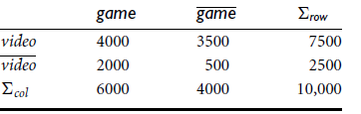
Strong Rules Are Not Necessarily Interesting
Let game => transactions contains computer games, and video => contains videos.
Of the 10,000 transactions analyzed
6000 transactions has computer games,
7500 included videos, and
4000 included both computer games and videos.
discover association rules using a minimum support of 30% and a minimum confidence of 60%.

Slide 36

Is is a strong association rule….but is misleading because the probability of purchasing videos is 75% (7500/10,000), which is even larger than 66%.
In fact, computer games and videos are negatively associated because the purchase of one of these items actually decreases the likelihood of purchasing the other.
Without fully understanding this phenomenon, we could easily make unwise business decisions.
This illustrates that the confidence of a rule A => B can be deceiving

Slide 37


From Association Analysis to Correlation Analysis
a correlation measure can be used to augment the support–confidence framework for association rules. This leads to correlation rules of the form
Lift is a simple correlation measure that is given as follows. The occurrence of itemset A is independent of the occurrence of itemset B if
The lift between the occurrence of A and B can be
measured by computing

Slide 38
LIFT
If Lift < 1, then the occurrence of A is negatively correlated with the occurrence of B, meaning that the occurrence of one likely leads to the absence of the other one.
If Lift >1, then A and B are positively correlated, meaning that the occurrence of one implies the occurrence of the other.
If the resulting value is equal to 1, then A and B are independent and there is no correlation between them.

Slide 39

LIFT
Lift is equivalent to which is also referred to as the lift of the association (or correlation) rule A =>B.
In other words, it assesses the degree to which the occurrence of one “lifts” the occurrence of the other.
For example, if A corresponds to the sale of computer games and B corresponds to the sale of videos, then given the current market conditions, the sale of games is said to increase or “lift” the likelihood of the sale of videos by a factor of the

Slide 40
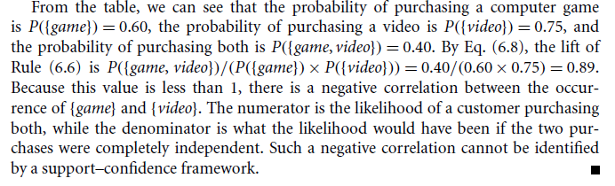
Conclusion

Slide 41
Eg: Interestingness Measure: Correlations (Lift)
play basketball ⇒ eat cereal [40%, 66.7%] is misleading
The overall % of students eating cereal is 75% > 66.7%.
play basketball ⇒ not eat cereal [20%, 33.3%] is more accurate, although with lower support and confidence
Measure of dependent/correlated events: lift
 | Basketball | Not basketball | Sum (row)
Cereal | 2000 | 1750 | 3750
Not cereal | 1000 | 250 | 1250
Sum(col.) | 3000 | 2000 | 5000

